Slide 1
Java Wrapper Classes
Java Regular Expressions
Java Date and Time
Java Generics

Slide 2
Java Wrapper Classes

Slide 3
Java Wrapper Classes
Wrapper classes provide a way to use primitive data types (int, boolean, etc..) as objects.
The table below shows the primitive type and the equivalent wrapper class:

Slide 4
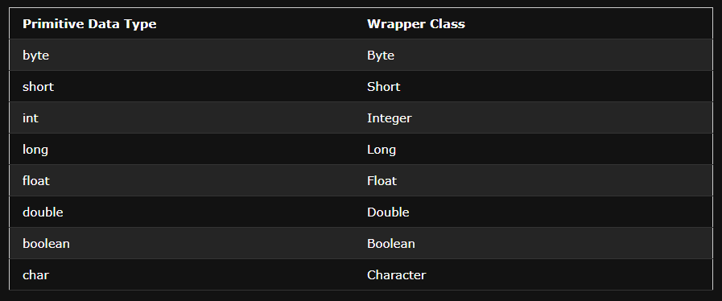

Slide 5
Sometimes you must use wrapper classes, for example when working with Collection objects, such as ArrayList, where primitive types cannot be used (the list can only store objects):
Example
ArrayList<int> myNumbers = new ArrayList<int>(); // Invalid
ArrayList<Integer> myNumbers = new ArrayList<Integer>(); // Valid

Slide 6
Java Regular Expressions

Slide 7
What is a Regular Expression?
A regular expression is a sequence of characters that forms a search pattern. When you search for data in a text, you can use this search pattern to describe what you are searching for.
A regular expression can be a single character, or a more complicated pattern.
Regular expressions can be used to perform all types of text search and text replace operations.

Slide 8
Java does not have a built-in Regular Expression class, but we can import the java.util.regex package to work with regular expressions. The package includes the following classes:
Pattern Class - Defines a pattern (to be used in a search)
Matcher Class - Used to search for the pattern
PatternSyntaxException Class - Indicates syntax error in a regular expression pattern

Slide 9
Example
Find out if there are any occurrences of the word "w3schools" in a sentence:
import java.util.regex.Matcher;
import java.util.regex.Pattern;
public class Main {
public static void main(String[] args) {
Pattern pattern = Pattern.compile(“IKTLAB", Pattern.CASE_INSENSITIVE);
Matcher matcher = pattern.matcher("Visit IKTLAB!");
boolean matchFound = matcher.find();
if(matchFound) {
System.out.println("Match found");
} else {
System.out.println("Match not found");
}
}
}
// Outputs Match found

Slide 10
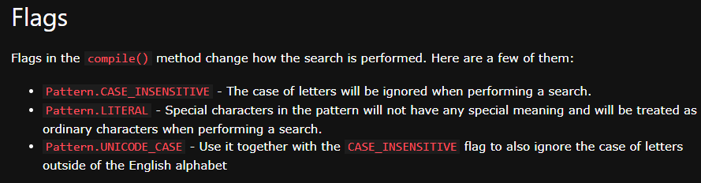

Slide 11
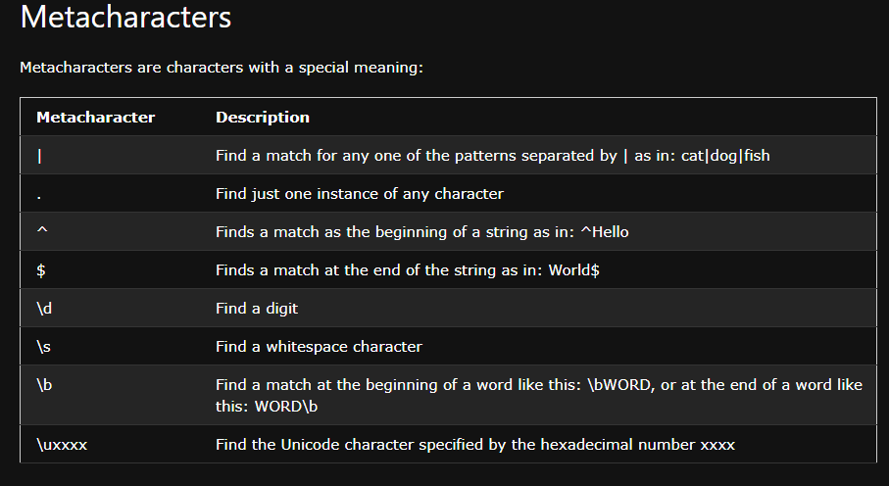

Slide 12
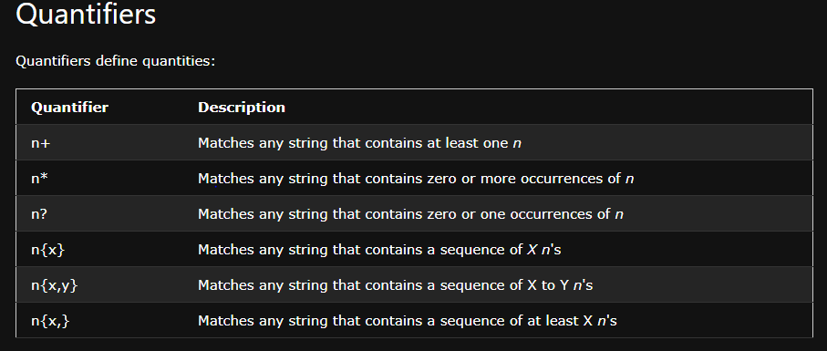

Slide 13
Note: If your expression needs to search for one of the special characters you can use a backslash ( \ ) to escape them. In Java, backslashes in strings need to be escaped themselves, so two backslashes are needed to escape special characters. For example, to search for one or more question marks you can use the following expression: "\\?"

Slide 14
Java Date and Time

Slide 15
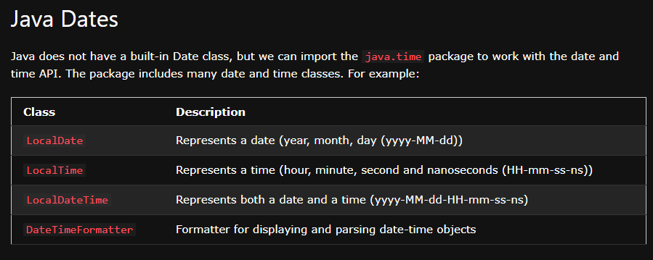

Slide 16
Display Current Date

Slide 17
Display Current Time

Slide 18
